Slide 1
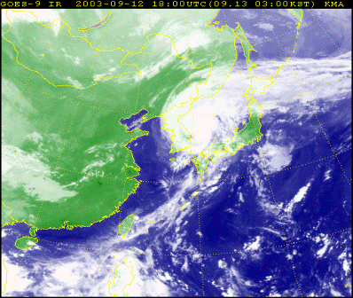

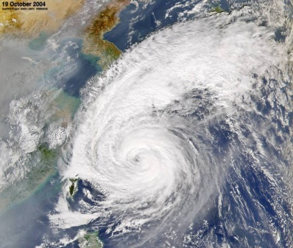

Distributed Rainfall Runoff Model
(K-DRUM)

Slide 2
Background and Purpose
Overview and Function
Application cases
User Guide

Slide 3
01
Background and Purpose

Slide 4

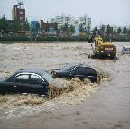


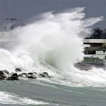




Typhoon!
Natural Disaster?
or a
Gift from Nature?
Notes:
When we hear about the word “typhoon” what really comes to our mind?
Is it a natural disaster? Or a gift from nature?
It can be a natural disaster if the excessive rain leads to flooding and inundation.
Or it can be a gift if reservoir catch the water as resource from the nature.
It all depends on how much we do to cope up with the typhoon.

Slide 5
Total amount of water resources and utilization
Total Water Resources
100%
River Runoff
Loss
58%
42%
River
Dam
Groundwater
Flood Discharge
10.8%
15%
3%
32%
Total Use
26%
Key Point of Water Resources Management
Reducing Flood Discharge in Summer Season
Notes:
Total water resources of Korea is about 130 billion ton per year.
58% of the total waters are classified as river runoff, while 42% of the water are loss. Losses are due to natural events such as evapotranspiration.
The river runoff is further distributed to rivers, dams, groundwater and or as a flood discharge.
Flood discharge is also considered as loss.
Water from rivers, dams and groundwater are known as consumable water, which are provided for numerous purposes.
Therefore, to be able to efficiently manage the water resources in Korea, the reduction of flood discharge should be addressed.

Slide 6
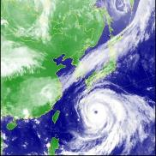
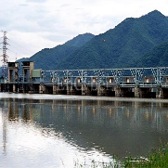

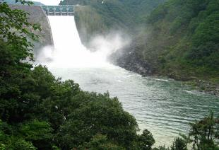





Main objective of water resource operation
Minimizing Flood Damage and Maximizing Water Utilization
Rainfall (Typhoon)
Storage (Dam)
Maximization
of Water Use
Efficiency
Agricultural
Domestic
Industrial
Environmental
Notes:
So, our main objective is to maximize water usage efficiency.
To be able to minimize flood damages, and maximize water utilization.
But how can we reduce the flooding and also provide sufficient waters for the country?
The answer lies with dams. Water from dams are widely used in our country.
And if we would like to maximize the water use efficiency, efficient reservoir management is very important.

Slide 7
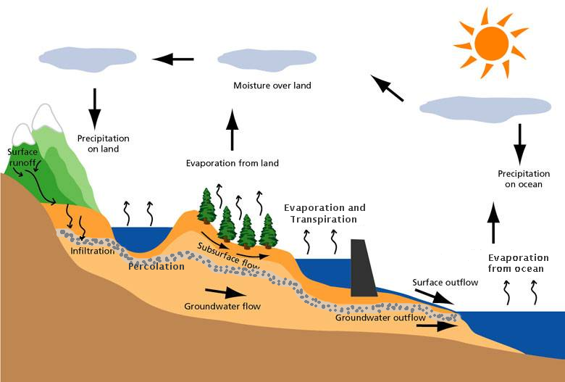
Water cycle and simulation systems
Precipitation Predictions System (PFS)
Flood Analysis System (FAS)
(K-DRUM)

Slide 8
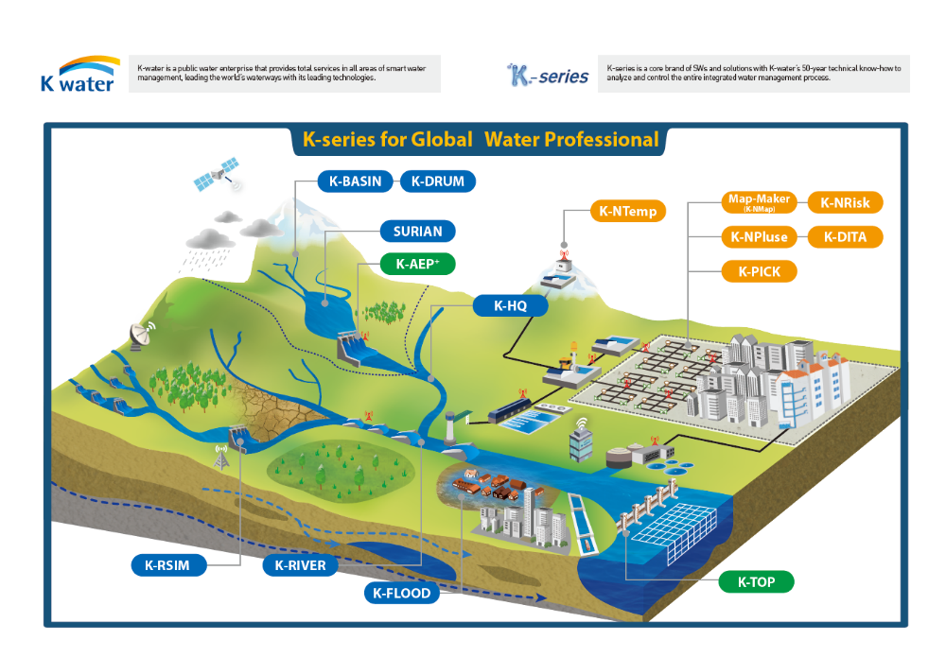
K-Series

Slide 9
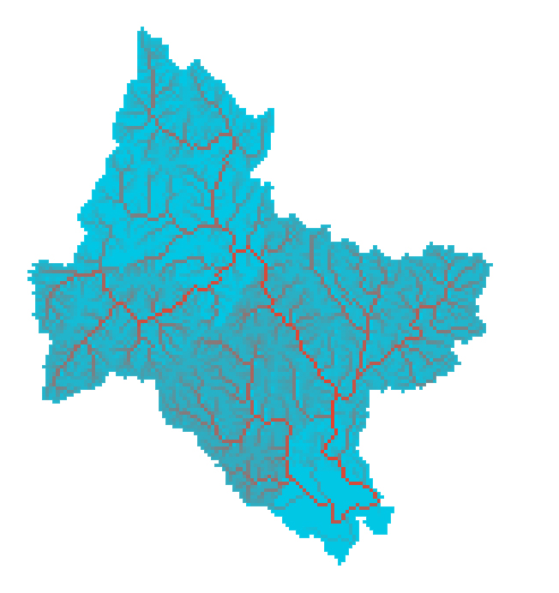
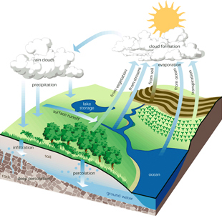
Why do we need a distributed runoff model
GIS/RS/GPS
Data
Distributed Runoff Model
Computing
Power
Predictive
Needs &
Power
Complex
Watershed
Characteristics
Notes:
분포형 수문모형은 ....이 있기 때문에 현재에도 많은 연구 개발이 진행되고 있습니다.

Slide 10

02
Overview and Function

Slide 11
Hydrologic model classification
Deterministic
Stochastic
Hydrodynamics
Black Box
Conceptual
Distributed
Lumped
Fully Distributed
Grid/Unit
Semi-Distributed
Subareas
Statistical
Distribution

Slide 12
Lumped vs Distributed model
Lumped Model
Distributed Model
R
R
R
R
R
R
Averaged
rain
R
R
R
R
R
R
Grid
rain
B1
B4
Averaged
parameters
R
R
R
B2
B3
S
S
S
S
C
S
Grid
parameters
B4
S
C
S
B1
B3
B2
Q
Q
Q
Q
Q
Q
Grid unit
results
Watershed unit
results
Q
Q
Q
Q

Slide 13





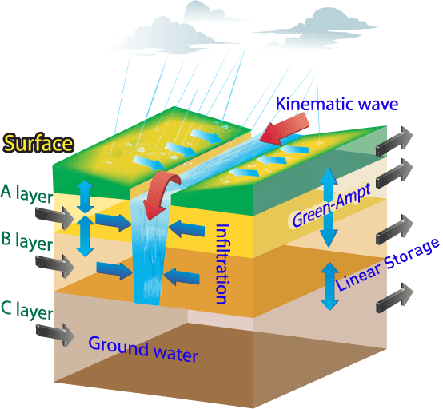
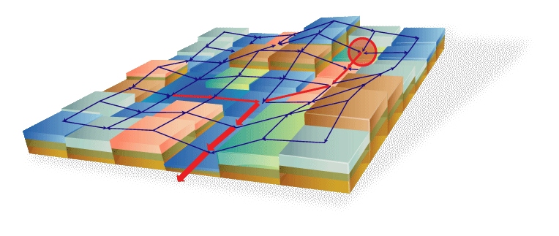

K-DRUM introduction
Grid based rainfall runoff model developed by K-water
Divide basin in to multiple grids and apply various physical characteristics (terrain-soil-vegetation, etc.)
Calculate infiltration from precipitation and other basin's circumstances, surface flow, subsurface flow, evapotranspiration, snow-melt, sediment

Slide 14
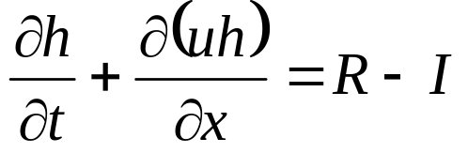
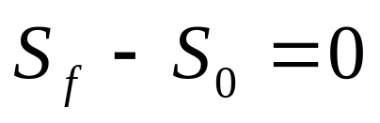
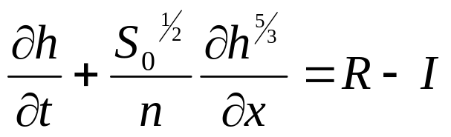
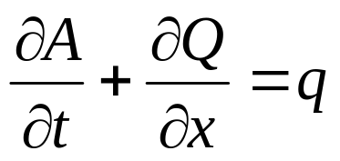
Basic Equation
Surface and Stream
Continuity Equation
Kinematic Wave Analogy
+
KWA for Surface Flow
KWA for Stream Flow
Finite Difference Method

Slide 15
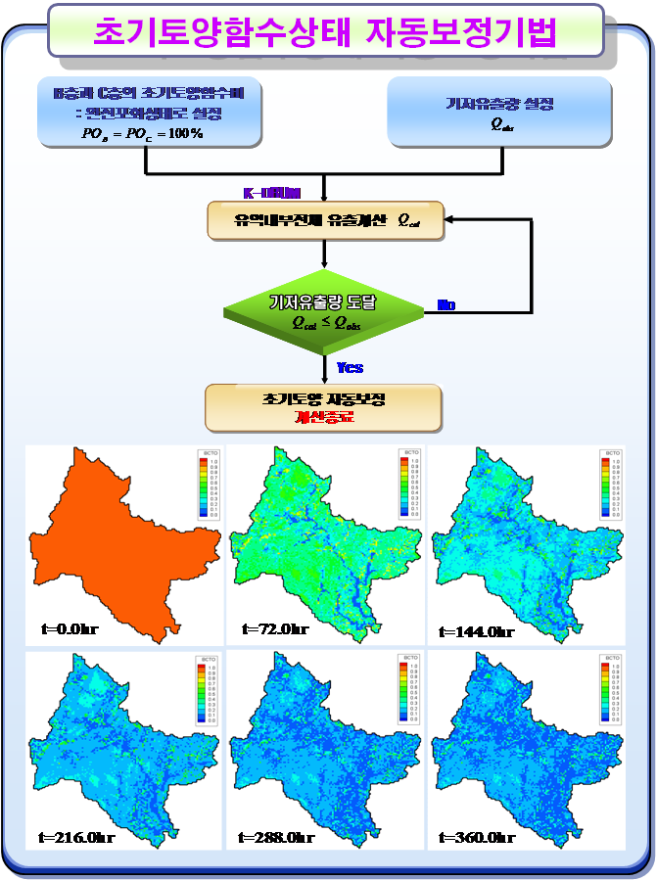
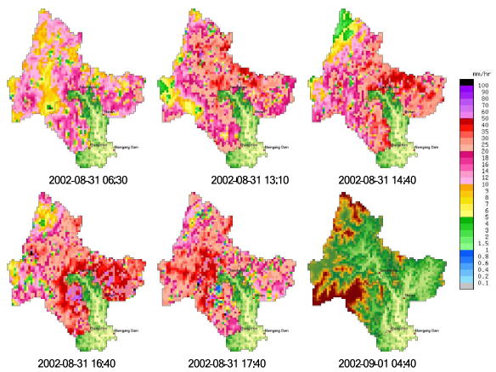
Useful Techniques
Automatic initial soil moisture
Spatial distribution of rainfall data
Long-term and short-term simulation
Simple sedimentation and water quality function
DB connection, Graphic user interface
Hourly data
Daily data
Linear interpolation
of data in time units
Simulation
(Time step=0.5min)
Result
(0.5min, 1hr, 1day)

Slide 16

03
Application Cases

Slide 17

Application and evaluation
Application Dam site
Dam site | Area | Grid size | Grid count | EFF | R²
Cheungju | 6,648㎢ | 500m | 26,765 | 0.912 | 0.962
Soyang | 2,703㎢ | 500m | 11,099 | 0.859 | 0.936
Hoengseong | 209㎢ | 100m | 20,738 | 0.891 | 0.927
Hantan gang | 1,279㎢ | 300m | 14,201 | 0.921 | 0.972
Andong | 1,584㎢ | 300m | 18,085 | 0.879 | 0.953
Imha | 1,361㎢ | 300m | 15,144 | 0.890 | 0.962
Hapcheon | 925㎢ | 200m | 23,225 | 0.891 | 0.937
Namgang | 2,285㎢ | 500m | 9,163 | 0.953 | 0.984
Milyang | 95.4㎢ | 100m | 10,342 | 0.858 | 0.954
Gunwi | 87.5㎢ | 60m | 24,305 | 0.503 | 0.801
Daecheong | 3,204㎢ | 500m | 13,180 | 0.852 | 0.902
Youngdam | 930㎢ | 250m | 14,876 | 0.901 | 0.933
Seomjingang | 763㎢ | 250m | 12,208 | 0.803 | 0.875
Juam | 1,010㎢ | 250m | 16,160 | 0.815 | 0.893
Buan | 59㎢ | 100m | 5,900 | - | -
Boryeong | 163.6㎢ | 100m | 16,360 | 0.793 | 0.845
Jangheung | 193㎢ | 100m | 19,300 | 0.831 | 0.882

Slide 18
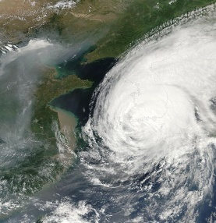
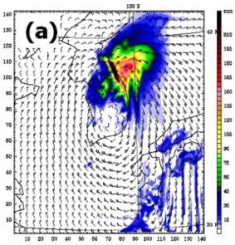
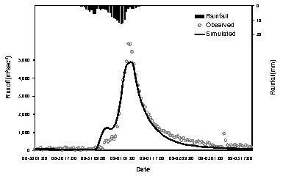
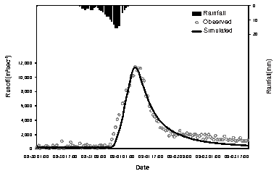
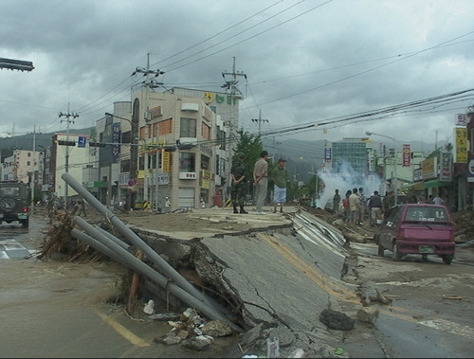
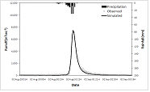
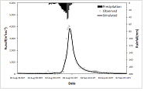
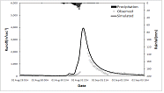

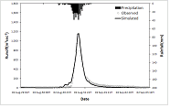
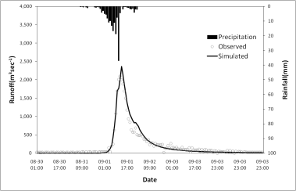
Typhoon ‘RUSA’
Typhoon RUSA
Simulation results
Han River
<Satellite image>
<Precipitation>
Nakdong River
<Typhoon damage>
Gum River
Other
4 Grade typhoon
Central Pressure : 950hPa
Max. Wind speed : 40m/s
Max. Precipitation : 870.5mm
Period : 2002. 8. 23-2002. 9. 1

Slide 19
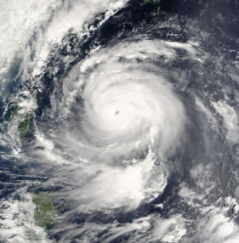
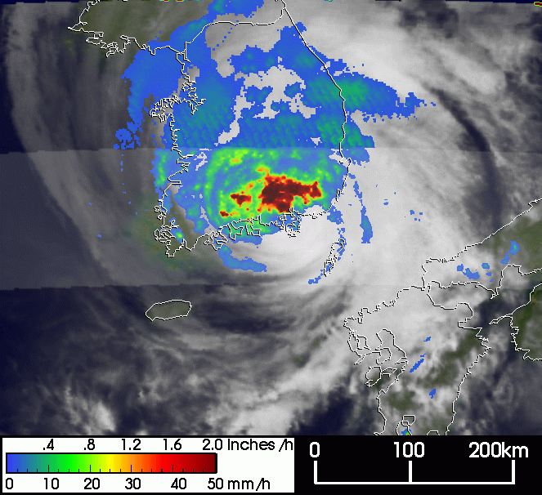
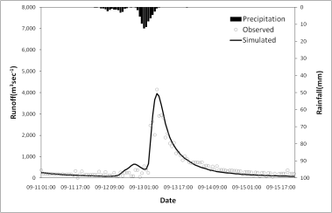
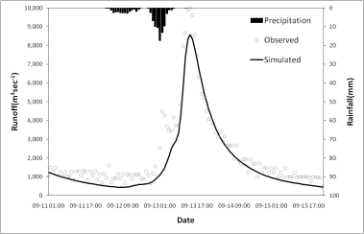
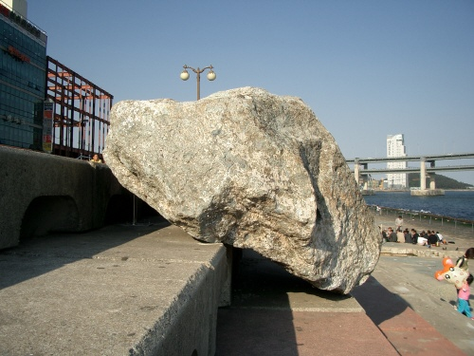
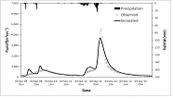
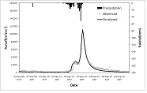
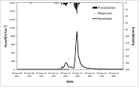
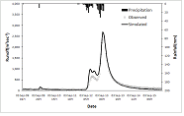
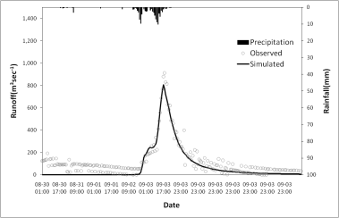
Typhoon ‘MAEMI’
Typhoon Maemi
Simulation results
Han River
<Satellite image>
<Precipitation>
Nakdong River
<Typhoon damage>
Gum River
Other
5 Grade typhoon
Central Pressure : 910hPa
Max. Wind speed : 55m/s
Max. Precipitation : 410mm
Period : 2003. 9. 6-2003. 9. 14

Slide 20
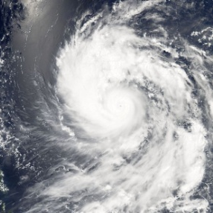
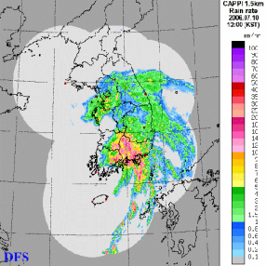
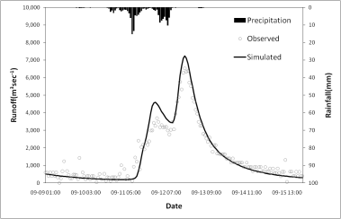
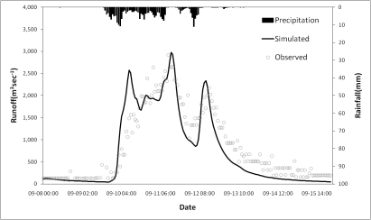
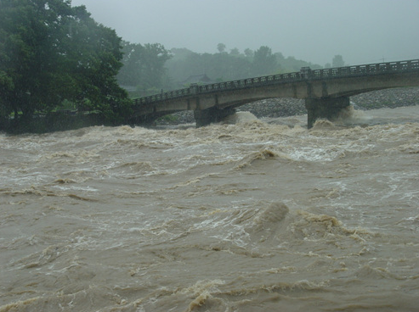
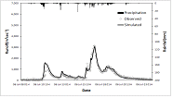
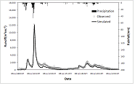
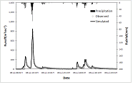
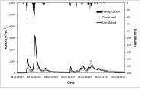
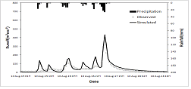
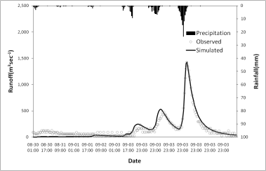
Typhoon ‘EWINIAR’
Typhoon Ewiniar
Simulation results
Han River
<Satellite image>
<Precipitation>
Nakdong River
<Typhoon damage>
Gum River
Other
4 Grade typhoon
Central Pressure : 930hPa
Max. Wind speed : 51m/s
Max. Precipitation : 200mm
Period : 2006. 7. 1-2006. 7. 10

Slide 21

Snow cover distribution and area
Observed : Terra MODIS, NOAA AVHRR Satellite data (Hong et. al., 2008)
Simulation : Snow distribution pattern is similar, area is slightly different
Snow cover area (unit : km²)
Date | ‘04.03.07 | ‘04.03.09 | ‘05.01.19 | ‘06.02.09 | ‘06.02.12
MODIS snow | 5,854.2 | 4,134.5 | 2,062.7 | 5,894.0 | 4,965.4
AVHRR snow | 5,945.0 | 4,962.0 | 2,591.2 | 5,832.5 | 4,829.4
K-DRUM | 5,209.9 | 4,948.5 | 2,196.5 | 6,639.6 | 6,634.0

Slide 22




Snow melt simulation
Gwangdong Dam
Simulation results
2010 yr
2011 yr
2012 yr

Slide 23



Long-term simulation
Hapcheon Dam
Simulation results
NSE | PBIAS (%) | RSR
0.86 (Very good) | -11.12 (Good) | 0.38 (Very good)
NSE | PBIAS (%) | RSR
0.76 (Very good) | -9.40 (Very good) | 0.45 (Very good)

Slide 24




High altitude basin(Parkistan patrind)
Simulation results

Slide 25

Automated rainfall-runoff forecasting system
System Networks

Slide 26





Automated rainfall-runoff forecasting system
July 2013 - Summer
Monsoon(‘13. 07. 02~09, 8days)
Previous simulation(3days) → worm-up & initial setting
Rainfall runoff simulation(5days) → forecast
Time series rainfall, runoff, release, water surface level
Soyang, Namgang and Hapcheon dam inflow information
Acquires and utilizes real-time rainfall data Analysis and dam inflow information are performed and displayed four times a day

Slide 27




Automated rainfall-runoff forecasting system

Slide 28



Surface flow and groundwater linkage
Linkage method
Surface runoff, interflow and recharge(K-DRUM), Ground-water flow and discharge(MODFLOW)
Final result : river flow(K-DRUM) + river discharge(MODFLOW)

Slide 29




Surface flow and groundwater linkage
Simulation process
Simulation result
Namgang Dam
Application period : 2016. 1.1~ 12.31 (Warm-up 10 yr)
Improved base flow accuracy

Slide 30



04
User Gide

Slide 31




Model setup
Model setup
Flowchart of model setup
[Original data]
[Input data]
[Model setup]
DEM
Landuse
Permeability
Soil depth
Soil type
Data evaluation
Quality of original data, hydrological characteristic and etc.
Selecting simulation period and major hydrologic case
Converting input data from original data

Slide 32


K-DRUM simulation sample(Uzbekistan)
Basin characteristics
DEM(digital elevation map)
Land use(land cover map)
Average slope is 33.30%
Average elevation is 2,585 m
Maximum elevation is 4,285 m
Major land cover class is grassland
Class | Water | Eroded | Grass | Forest | Crop
Area(%) | 0.16 | 1.11 | 79.73 | 9.09 | 9.91

Slide 33

K-DRUM simulation sample(Uzbekistan)
Setup K-DRUM
Using K-DRUM GUI
Simulate during 1 yr (1992)
Daily based input data

Slide 34


K-DRUM simulation sample(Uzbekistan)
Converting Precipitation
Convert the observed precipitation data to rainfall data
Considering temperature of each gird elevation
Converted rainfall data concentrate on the summer season
Snow depth varies during year and related with temperature
Low temperature is snow
High temperature is rainfall

Slide 35



K-DRUM simulation sample(Uzbekistan)
우즈베키스탄 유역
Using K-DRUM GUI
Simulate during 1 yr (1992)
Daily based input data

Slide 36
Thank you

